Slide 1
Chatbots with Seq2Seq
Instructor: Assoc.Prof. Le Anh Cuong
Ngo Minh Tuan – 51503629

Slide 2
OUtline
01
Introduction:
Chatbots
02
Theorical issues:
Seq2Seq & attention mechanisms, RNN, LSTM, GRU
03
Demo:
Chatbots with Seq2Seq
1

Slide 3


Chatbot?
A chatbot is a program that communicates with you,
you can communicate with via text messages.
The chatbot can talk to you through different channels such as:
Fb Messenger, Siri, WeChat, SMS, Skype, and many others.
2

Slide 4
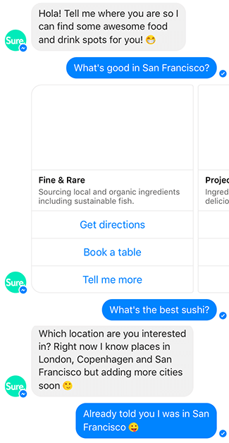
Rule-based & Intelligent Chatbots?
Rule-based Chatbots that function on predefined rules
and can answer to only limited queries or questions.
A good rule-based chatbot requires a thorough
input of possible patterns and responses.
This type of chatbot lacks the adaptability and analytic
capabilities of a human being to well understand
a person’s expectations and intentions.
3

Slide 5
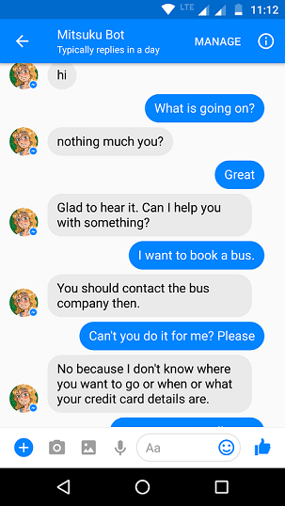
Rule-based & Intelligent Chatbots?
Intelligent Chatbots leverage Machine Learning
and Natural Language Processing to deliver
more natural conversation.
It not only understands requests but also context,
intent, emotion and it continuously gets smarter
as it learns from conversations it has with users.
4

Slide 6

The benefits & limitations of Chatbots?
A customer service channel that is always open, that can conduct multiple conversations
with multiple users simultaneously, and that provides instantaneous responses.
From optimal use of time, enhanced customer service and customer knowledge to instant
chat, each of a chatbot’s strengths is perfectly aligned with customer care.
Every time a chatbot interacts with a user, it generates a conversation log.
5

Slide 7
OUtline
01
Introduction:
Chatbots
02
Theorical issues:
Seq2Seq & attention mechanisms, RNN, LSTM, GRU
03
Demo:
Chatbots with Seq2Seq
6

Slide 8
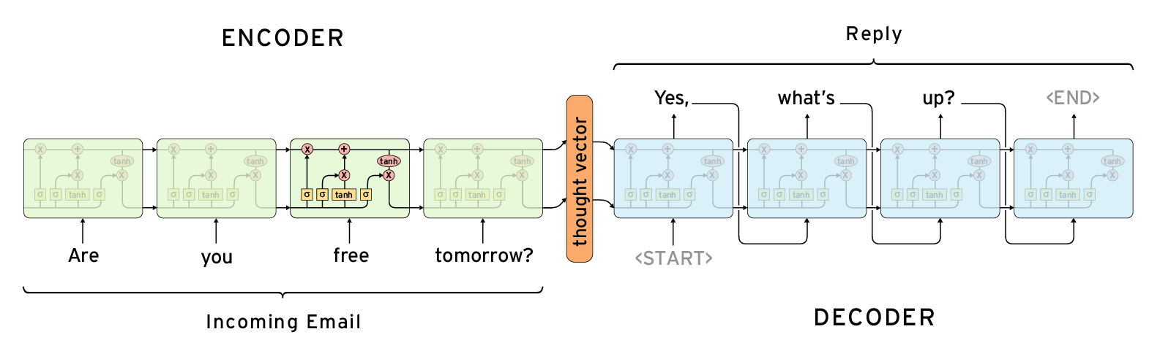
Seq2Seq?
Problem: We need to generate an output sequence from a given input sequence to provide answers
to the user's conversation, as a Dialogue System.
Seq2Seq model (also known as encoder-decoder)
7

Slide 9
Seq2Seq?
It consists of two RNNs (Recurrent Neural Network): an Encoder and a Decoder.
The encoder takes a sentence as an input
and processes the characters and words.
The encoder converts a word into vectors of the same size,
containing only the necessary information.
The decoder will generate the sequence (the answer is generated).
Each decoder step will be affected by the word created in the previous step.
8

Slide 10
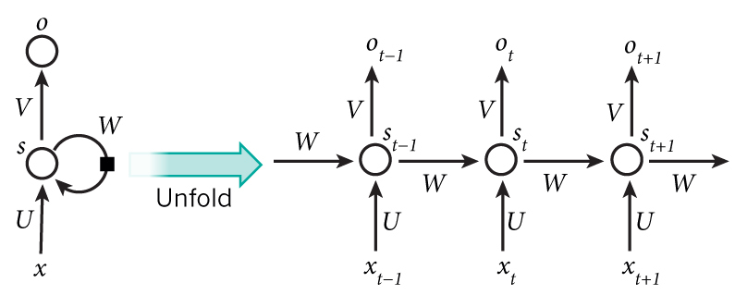
Seq2Seq RNNs?
The RNN network models the nature of data in NLP,
which has string characteristics and components such as:
words and phrases in data interdependent, has the ability to remember previously calculated information.
9

Slide 11
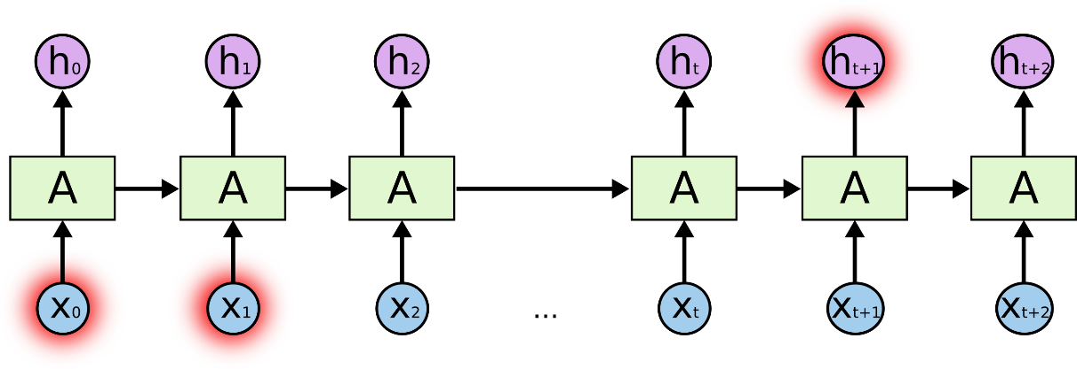
Seq2Seq RNNs?
Problem: Long-term dependency
“Các đám may trên bầu trời“.
“I grew up in France… I speak fluent French.”
Long Short Term Memory networks.
Gated-Recurrent Unit.
10

Slide 12
Seq2Seq LSTM & GRU?
LSTM & GRU are an improved form of RNN, they is capable of learning
and remembering over long sequences of inputs.
Using the "Gates" mechanism to add new infor and eliminate unnecessary info
from "memory", which helps to increase RNN's ability to store important infor.
Using a "tanh" and "Sigmoid' function to determine what infor should be stored
and which information should be discarded.
11

Slide 13
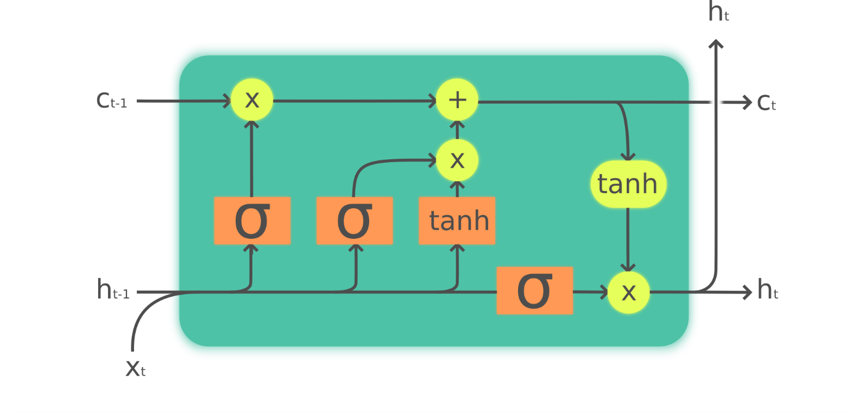
Seq2Seq LSTM?
The cell structure of LSTM is made up of 3 gates:
Forget gate, Input gate, and Output gate.
12

Slide 14
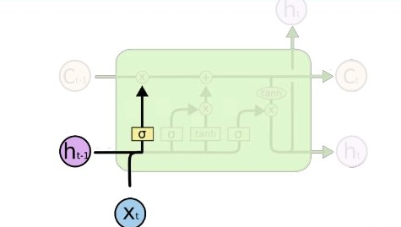
Seq2Seq LSTM?
Forgot gate: Decide whether the Cell state information at time step t-1 should be stored.
Infor from Current input & Hidden state are passed to the "Sigmoid" function
with the output in the range [0, 1].
13
13

Slide 15
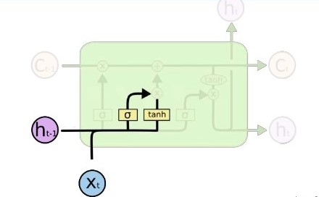
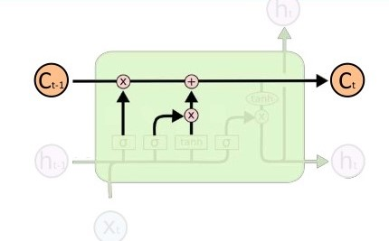
Seq2Seq LSTM?
Input gate: Update information into Cell state,
multiplying Sigmoid's output with Tanh's output
decide whether the Cell state infor of Current input & Hidden state should be stored.
14

Slide 16
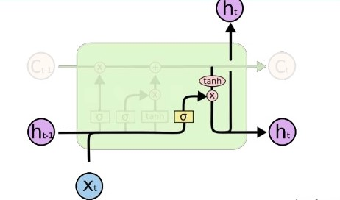
Seq2Seq LSTM?
Output gate: Calculate the value of the hidden state for the next timestep.
The value of this new Hidden state is also the value of Prediction.
LSTM has 3 inputs and 2 outputs
include the cell state,
and the hidden state.
15

Slide 17
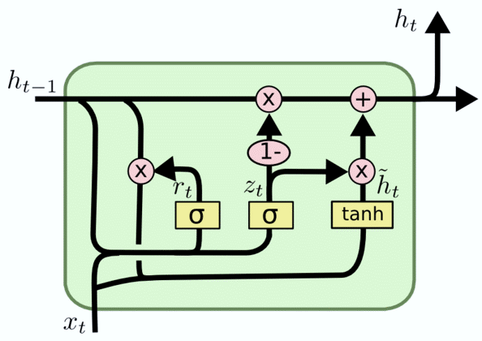
Seq2Seq GRU?
The cell structure of LSTM is made up of 2 gates:
Reset gate, Update gate.
GRU is a version of LSTM with the same operating principles as LSTM but with a simpler structure.
16

Slide 18
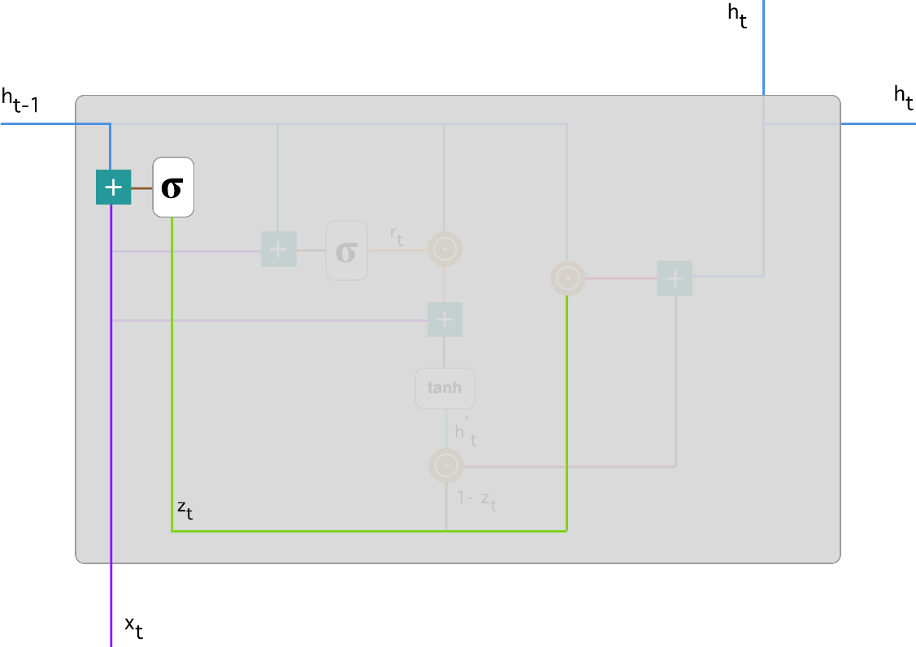
Seq2Seq GRU?
Update gate: this gate helps the model to determine how much of the past information (from previous time steps) needs to be passed along to the future.
We plug in h_(t-1) and x_t,
multiply them with their corresponding weights,
sum the results and apply the sigmoid
function.
17

Slide 19
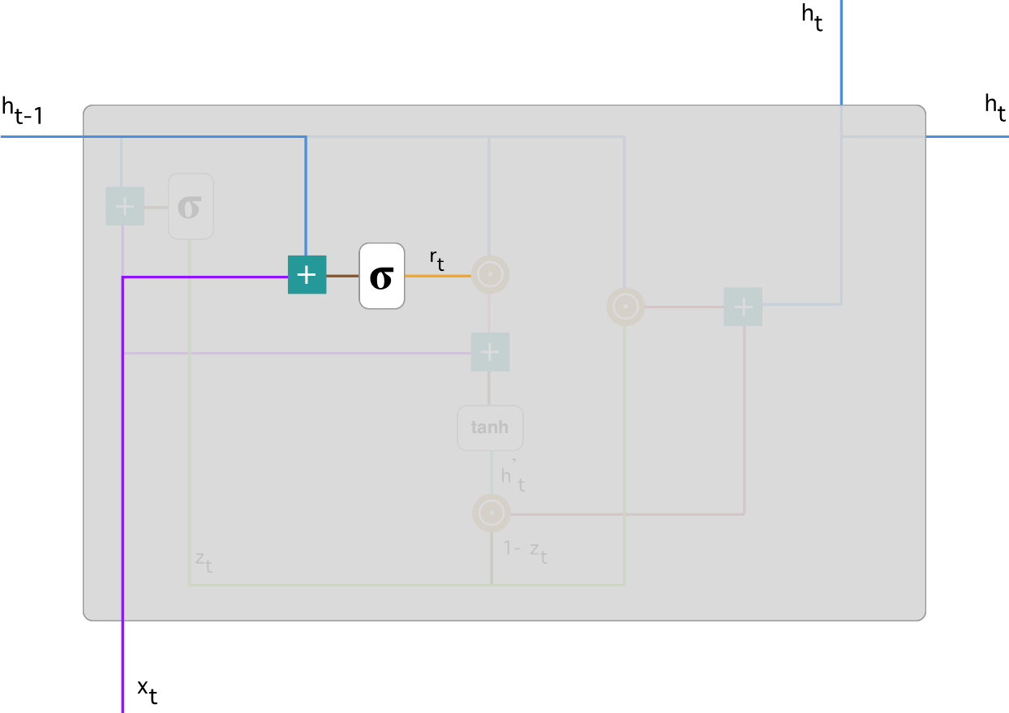
Seq2Seq GRU?
Reset gate: this gate is used from the model to decide how much of the past information to forget.
18

Slide 20
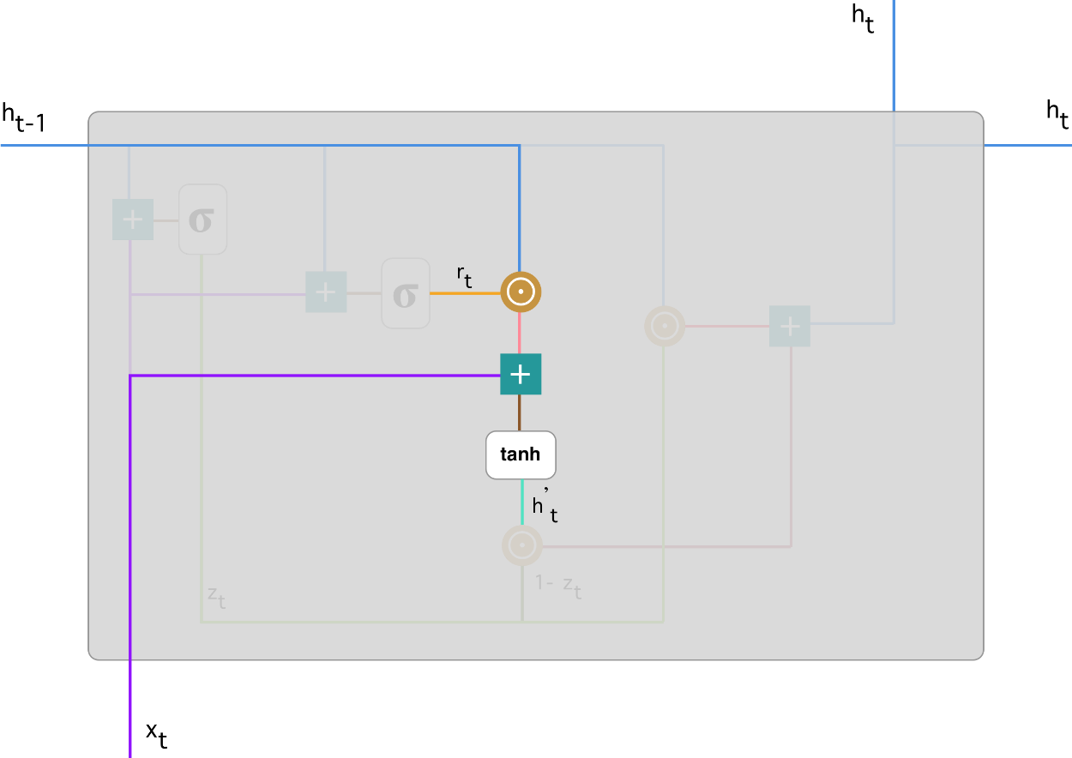
Seq2Seq GRU?
Current memory content:
Sum up the results of step 1 & 2
Apply the nonlinear activation function tanh
19

Slide 21
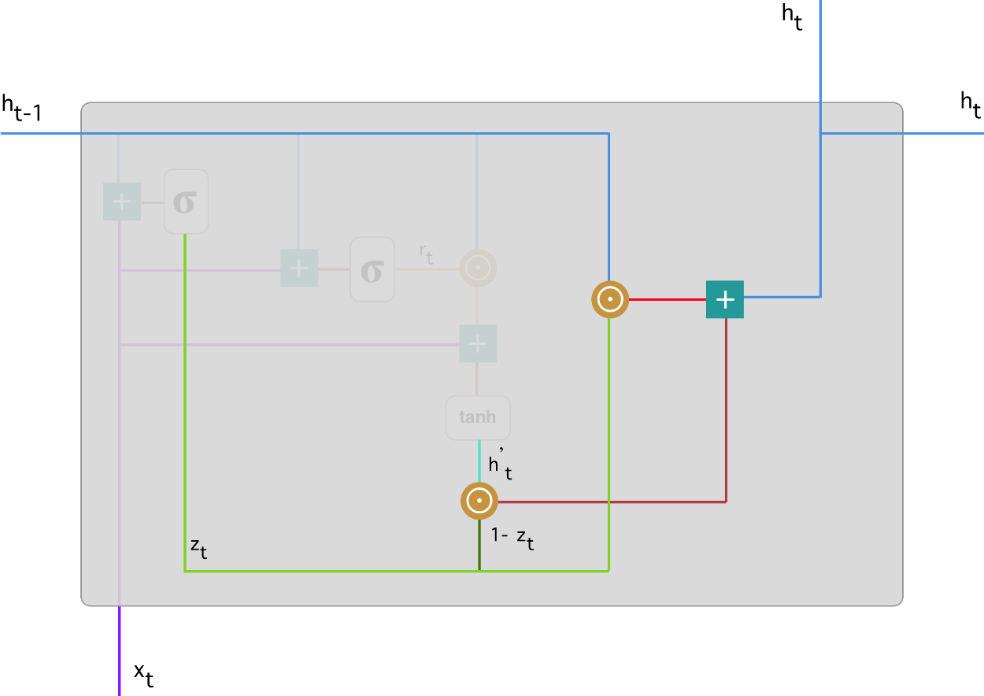
Seq2Seq GRU?
Final memory at the current time step:
Multiplication z_t & h_(t-1).
Multiplication (1-z_t) & h’_t.
Sum the results from steps 1 & 2.
20

Slide 22
Seq2Seq LSTM & GRU?
LSTM can store information with longer data than GRU.
However, due to its simple structure, GRU is usually faster than LSTM and can be easily used to build complex structured networks.
The use of LSTM and GRU depends on the specific problem requirements
21

Slide 23
OUtline
01
Introduction:
Chatbots
02
Theorical issues:
Seq2Seq & attention mechanisms, RNN, LSTM, GRU
03
Demo:
Chatbots with Seq2Seq
22

Slide 24
Demo Chatbot with Seq2Seq
23

